Slide 1

105 Classification Models
Sunil Gorantla

Slide 2
Naïve Bayes
What is Naive Bayes?
A probabilistic classifier based on Bayes' Theorem.
Assumes independence between predictors (features).
Simplistic yet effective for certain types of data.
Why "Naive"?
The assumption that all features are independent and equally contribute to the outcome.
Despite the "naive" assumption, it often performs surprisingly well.

Slide 3
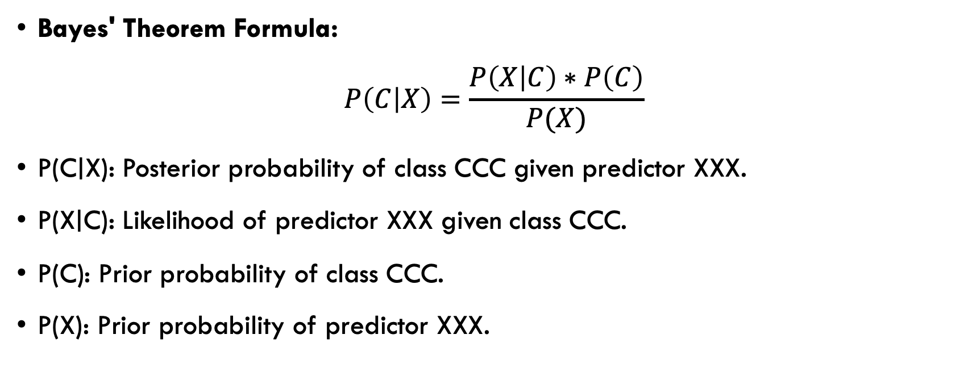
Bayes' Theorem Overview
Bayes' Theorem Formula:
$$P\left(C | X\right)=\frac{P\left(X | C\right)∗P\left(C\right)}{P(X)}$$
P(C∣X): Posterior probability of class CCC given predictor XXX.
P(X∣C): Likelihood of predictor XXX given class CCC.
P(C): Prior probability of class CCC.
P(X): Prior probability of predictor XXX.

Slide 4
Naive Bayes Classifier Types
Gaussian Naive Bayes:
Assumes the features follow a normal (Gaussian) distribution.
Multinomial Naive Bayes:
Used for discrete counts (e.g., text classification).
Bernoulli Naive Bayes:
Used for binary/Boolean features.

Slide 5

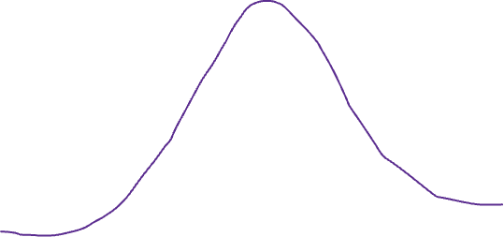
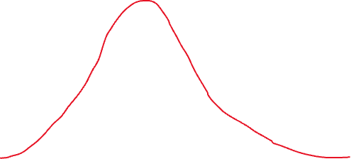


Slide 6
Naive Bayes Assumptions
Key Assumptions:
Feature independence: Each feature contributes independently to the final decision.
Equal importance: Every feature is equally important in determining the outcome.
Real-World Considerations:
These assumptions rarely hold true, but Naive Bayes can still perform well in practice, especially with a large dataset.

Slide 7
Training a Naive Bayes Classifier
Training Steps:
Calculate Prior Probability:
Estimate P(C)P(C)P(C) for each class based on the training data.
Calculate Likelihood:
Estimate P(X∣C)P(X|C)P(X∣C) for each feature given each class.
Apply Bayes’ Theorem:
Use the formula to compute the posterior probability for each class.
Predict Class:
Choose the class with the highest posterior probability.

Slide 8
Advantages and Disadvantages
Advantages:
Simple to implement and understand.
Fast to train and predict.
Performs well with a large number of features.
Works well for text classification tasks.
Disadvantages:
The strong assumption of independence between features.
May not perform well with correlated features.
Can struggle with small datasets or when the assumption of normality is violated.

Slide 9
This book is stored in google library book.
Google is a search engine
Lion is the king of jungle
[1, 2, 1, 1, 1, 1, 1, 0, 0, 0, 0, 0, 0, 0, 0]
[0, 0,1, 0, 0, 1, 0, 1, 1, 1, 0, 0, 0, 0, 0]
Corpus: list of unique words
[This, book, is, stored, in, google, library, a, search, engine, Lion, the, king, of, jungle]

Slide 10
SVM (Support Vector Machine)
What is SVM?
A supervised machine learning algorithm used for classification and regression tasks.
Aims to find the optimal hyperplane that maximizes the margin between different classes.
Key Concept:
The margin is the distance between the hyperplane and the nearest data points from either class. The larger the margin, the better the model’s generalization.

Slide 11
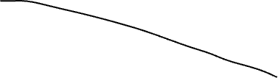

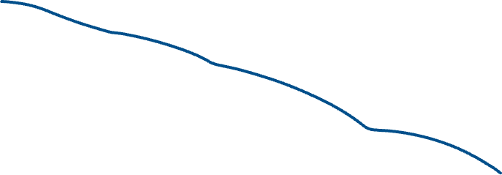

Slide 13
How SVM works
Separating Hyperplane:
In a two-dimensional space, SVM finds a line (hyperplane) that best separates the data into classes.
For higher-dimensional spaces, the hyperplane becomes a plane or hyperplane.
Support Vectors:
The data points that are closest to the hyperplane.
These points are critical in defining the position and orientation of the hyperplane.

Slide 14
Kernel
What is the Kernel Trick?
Allows SVM to perform non-linear classification.
Maps the input features into a higher-dimensional space where a linear separator can be found.
Common Kernels:
Linear Kernel: Used when data is linearly separable.
Polynomial Kernel: Maps input space into a higher-dimensional polynomial space.
Radial Basis Function (RBF) Kernel: Maps features into an infinite-dimensional space, suitable for non-linear data.
Sigmoid Kernel: Similar to a neural network's activation function.

Slide 15
Binary Classification:
SVM is primarily designed for binary classification tasks.
Finds the best hyperplane to separate the two classes.
Multi-Class Classification:
Approaches include One-vs-One and One-vs-Rest.
One-vs-One: SVM trains a classifier for every pair of classes.
One-vs-Rest: SVM trains a single classifier per class, with the class against all others.

Slide 16
Hyper Parameters
Feature Scaling: SVMs are sensitive to the magnitude of features, so scaling (e.g., normalization or standardization) is crucial.
Parameter Tuning:
C Parameter: Controls the trade-off between achieving a low error on training data and a low margin.
Gamma (for RBF kernel): Defines how far the influence of a single training example reaches.

Slide 17
Knn(K-Nearest neighbors)
Distance = sqrt( ( point1_size – point2_size)^2 + (point1_color – point2_color)^2)

